Slide 1
Controller
common
FrontController
member
MemberInsertServlet
product
MemberContentServlet
MemberModifyServlet
MemberModifyValueServlet
ProductListServlet
ProductInsertServlet
ProductModifyServlet
MemberCheckLoginServlet
ProductFileServlet
ProductReviewServlet
ProductInquiryServlet
ProductDetailServlet
ProductDiliveryServlet

Slide 2
Controller
question
QuestionListServlet
AnnounceBoard
Dilivery
QuestionContentServlet
QuestionWriteServlet
QuestionModifyServlet
QuestionCategoryServlet
AnnounceBoardListServlet
DiliveryListServlet
DiliveryContentServlet
AnnounceBoardContentServlet
AnnounceBoardWriteServlet
AnnounceBoardModifyServlet
AnnounceBoardDeleteServlet
QuestionDeleteServlet
AnnounceBoardDateServlet
AnnounceBoardHitServlet
DiliveryAddressServlet
DiliveryInfoServlet

Slide 3
Controller
Qnaservice
QnaserviceListServlet
Mypage
allboard
QnaserviceContentServlet
QnaserviceWriteServlet
QnaserviceModifyServlet
QnaserviceCategoryServlet
NoticeboardListServlet
AllBoardListServlet
AllBoardContentServlet
NoticeboardContentServlet
NoticeboardWriteServlet
NoticeboardModifyServlet
NoticeboardDeleteServlet
QnaserviceDeleteServlet
NoticeboardDateServlet
NoticeboardHitServlet
QnaserviceAddFileServlet

Slide 4
Controller
admin
MemberListServlet
MemberDeleteServlet
AnnounceBoardListServlet
AllBoardWriteServlet
AllBoardModifyServlet
AllBoardDeleteServlet
ProductListServlet
ProductInsertServlet
ProductModifyServlet
ProductDeleteServlet
AnnounceBoardContentServlet
AnnounceBoardModifyServlet
AnnounceBoardDelateServlet

Slide 5
Service
member
MemberService
cashdonation
allpay
MemberServiceImpl
MemberVo
CashDonationService
AllPayService
AllPayServiceImpl
CashDonationInServiceImpl
CashDonationVo
AllPayVo

Slide 6
Service
question
QuestionService
talentboard
allboard
QuestionServiceImpl
QuestionVo
TalentBoardService
AllBoardService
AllBoardServiceImpl
TalentBoardServiceImpl
TalentBoardVo
AllBoardVo

Slide 7
Service
admin
AdminService
AdminServiceImpl
DonationListVo

Slide 8
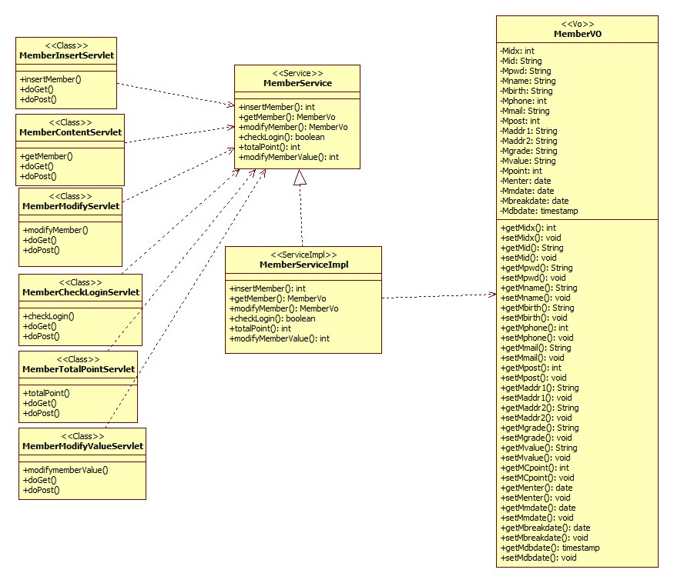
<member>

Slide 9
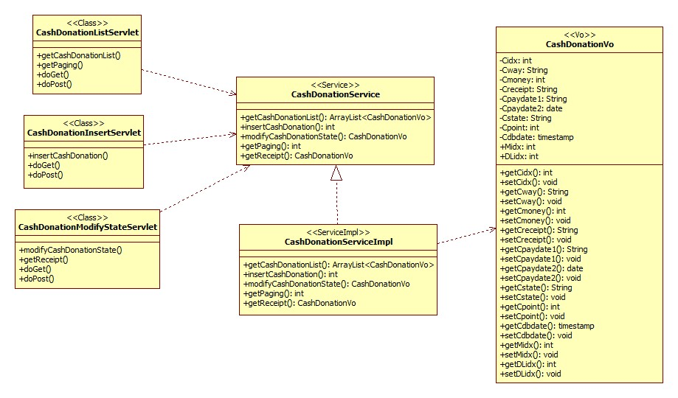
<cashdonation>

Slide 10
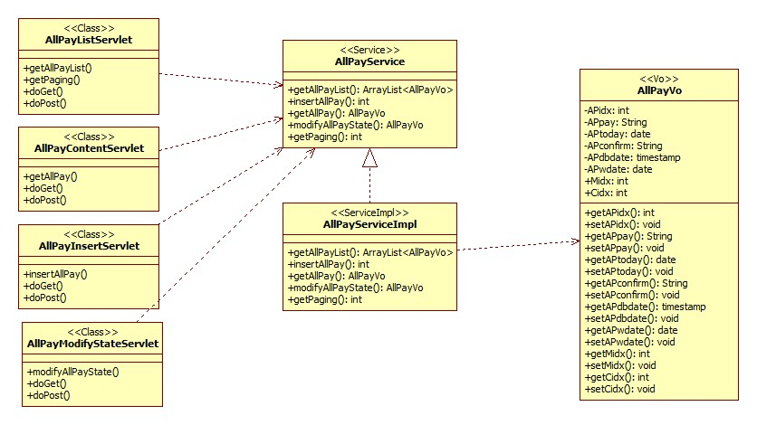
<allpay>

Slide 11
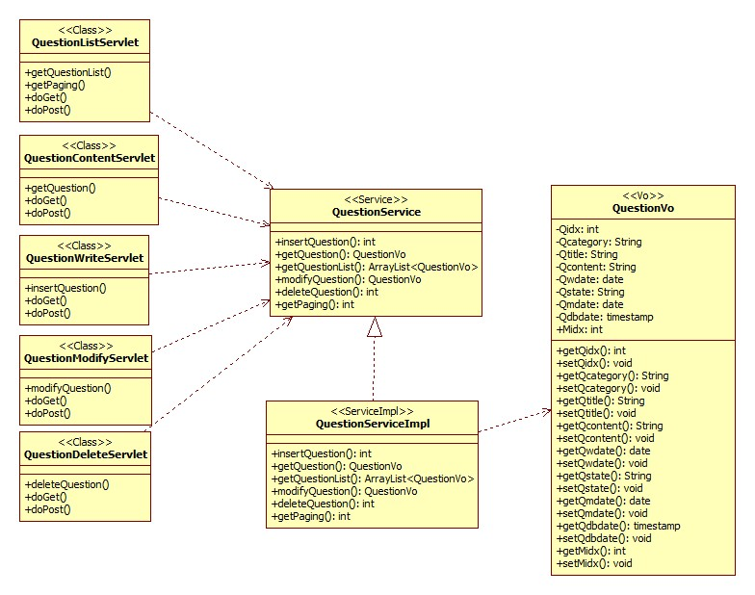
<question>

Slide 12
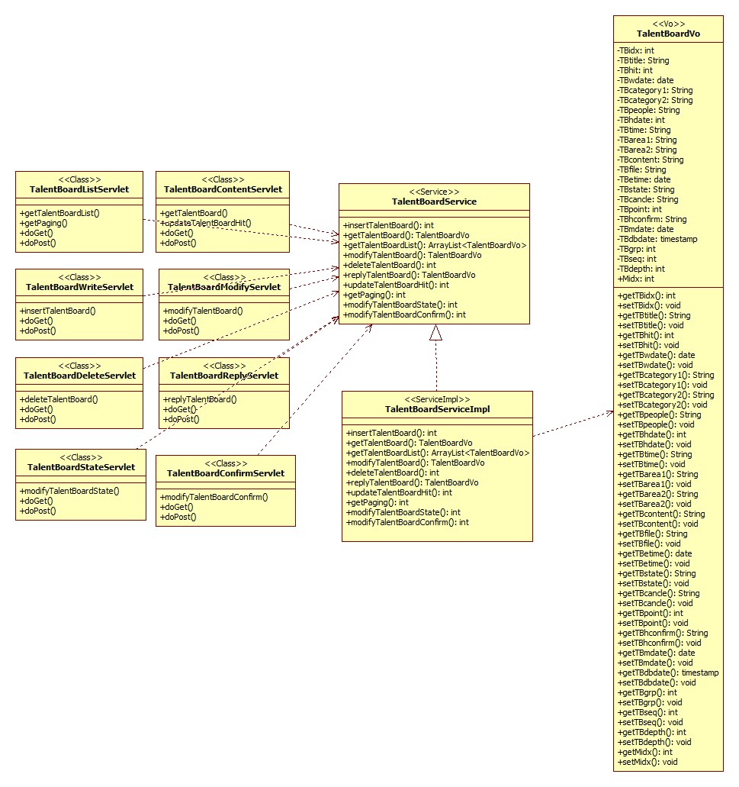
<talentboard>

Slide 13
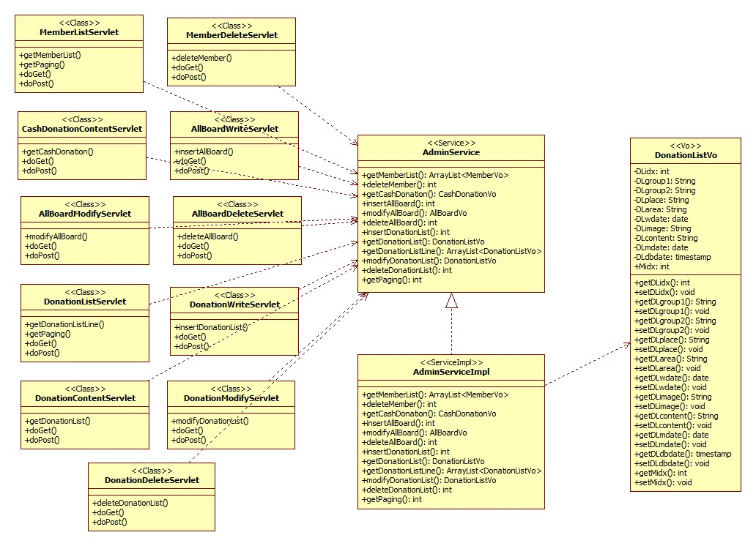
<admin>

